Slide 2


Manu Delgado
Azure MVP
Divulgador Tecnológico en [T]
Responsable Cloud en Pasion
mdelgado@pasiona.com
@
@mdelgadodiaz83
mdelgadodiaz83@gmail.com

Slide 3
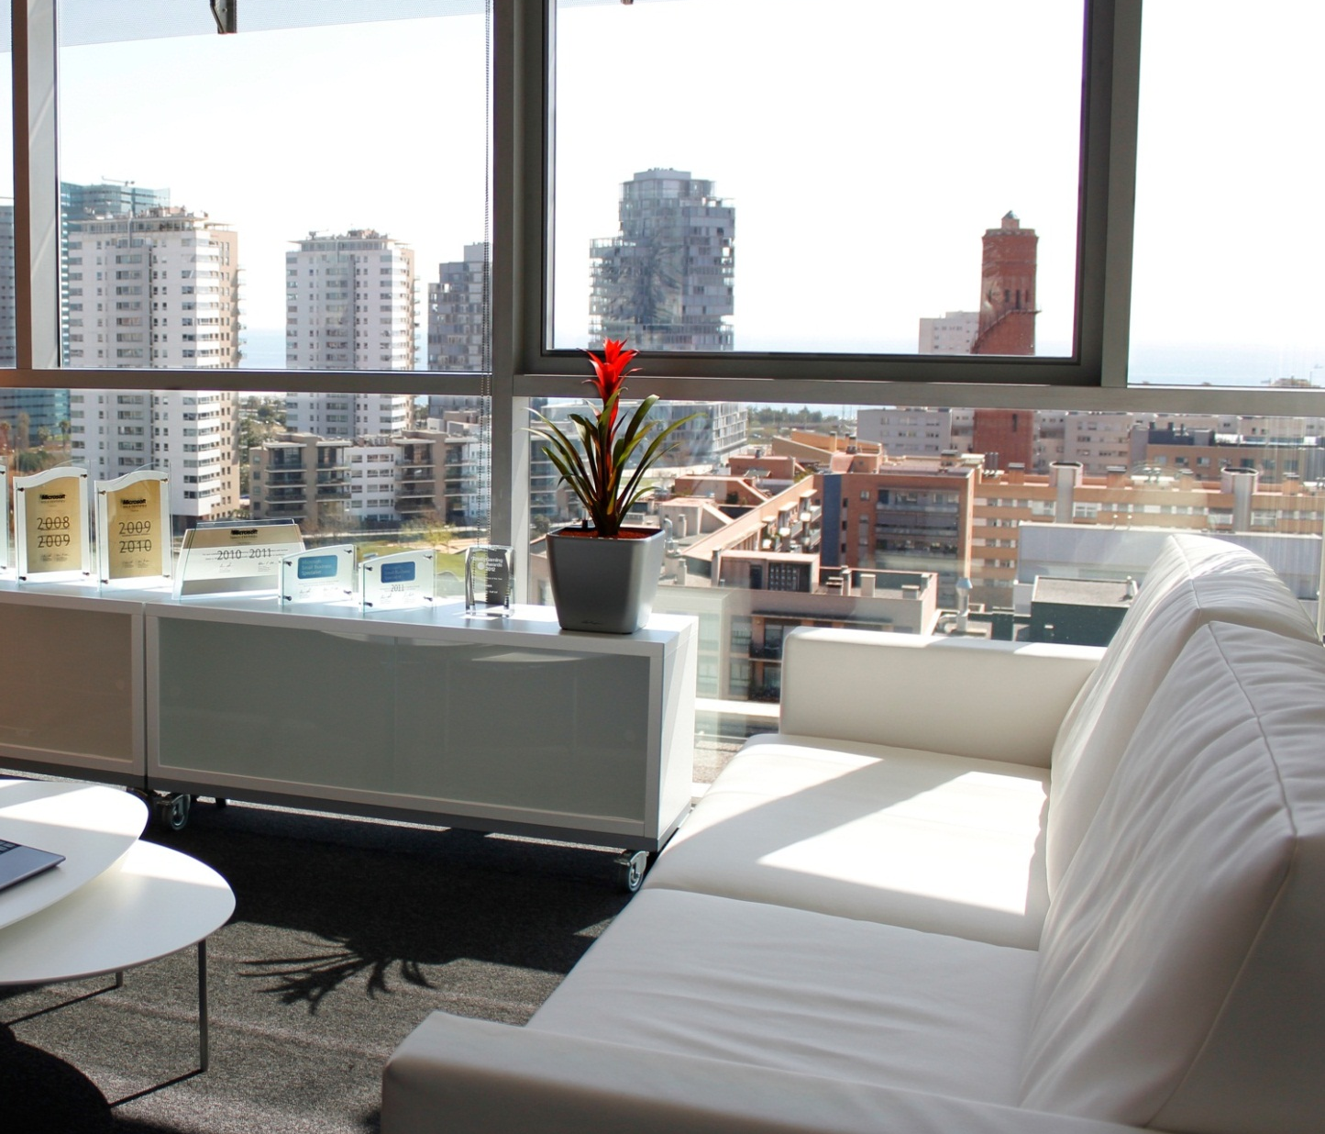





www.pasiona.com
info@pasiona.com
(+34) 669 333 333
@pasiona
Barcelona
Pujades 350, 10ª planta 08019 · Barcelona
Madrid
Pinar 5, 28006 · Madrid

Slide 4
Cómo montar tu propio motor de búsqueda

Slide 5
Conceptos básicos

Slide 6

SaaS (Search as a service)
Conceptos básicos
Escalable y administrado
HTTP RESTful API

Slide 7
Conceptos básicos
Esquema
Características ( Searchable, filterable, retrievable, sortable, etc..)
Index
Documents ( RESTful API, .net SDK )

Slide 8
Conceptos básicos
SQL Database
DataSource
DocumentDB
Blob Storage (Preview)
Table Storage (Preview)

Slide 9
Conceptos básicos
Programado
Diferenciales
Indexer
RESTful API
.Net SDK

Slide 10


Slide 11
Preferred text layout (no bullets)
Main topic 1: size 40pt
Size 20pt for the subtopics
Size 20pt for the subtopics
Main topic 2: size 40pt
Size 20pt for the subtopics
Size 20pt for the subtopics
Main topic 3: size 40pt
Size 20pt for the subtopics
Size 20pt for the subtopics

Slide 12
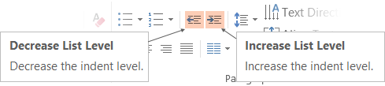
Adjusting list levels
Main topic 1: size 40pt
Size 20pt for the subtopics
Size 20pt for the subtopics
Main topic 2: size 40pt
Size 20pt for the subtopics
Size 20pt for the subtopics
Main topic 3: size 40pt
Size 20pt for the subtopics
Size 20pt for the subtopics
Use the “Decrease List Level” and “Increase List Level” tools on the Home Menu to change text levels.
Try this:
Place your cursor in any row of text to the left that says “Size 20pt for subtopics”
Next click the Home tab, and then on the “Decrease List level” tool. Notice how the line moves up one level.
Now try placing your cursor in one of the “Main topic…” lines of text. Click the “Increase List Level” tool and see how the text is pushed in one level
Use these 2 tools to adjust your text levels as you work

Slide 13
Bullet points layout with subtitle Subtitle
Example of a bulleted slide with a subhead
Set the slide title to “Sentence case”
Set subheads to “Sentence case”
Hyperlink style
www.microsoft.com

Slide 14
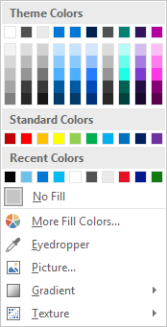
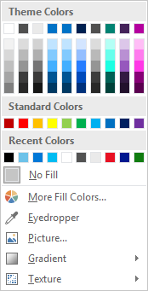
Slide palette info
The PowerPoint palette for this template has been built for you and is shown below. Avoid using too many colors in your presentation.
Select the 4th color from the left for subheads and 1st level non-bulleted text color, or wherever “color” text is preferred over the default black/white text
Accent colors 1-6 – (6 Theme Colors to the far right)
Text
Dark 2
Accent 1
Accent 2
Accent 3
Accent 4
Accent 5
Accent 6
Use Accent 1 as the main accent color. Use Accent 2 and Accent 3 when additional colors are needed.
Use Accents 4-6 sparingly – only when more colors are necessary.

Slide 15
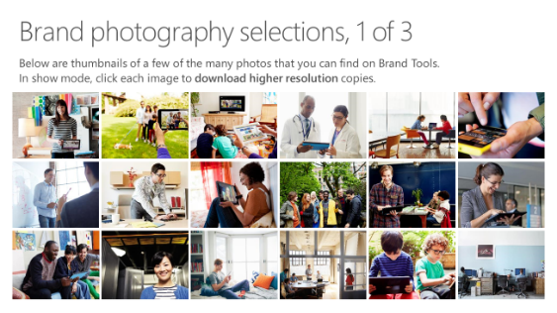
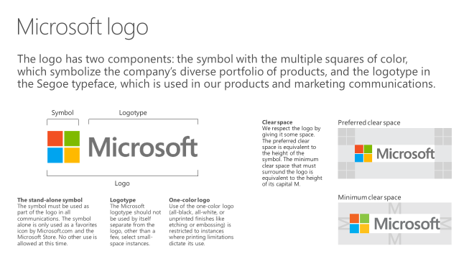
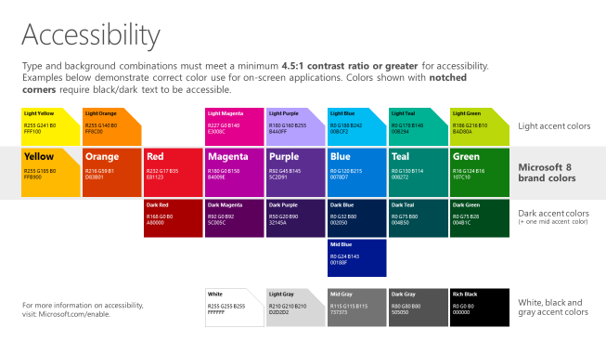
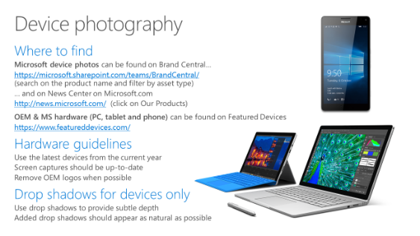
Microsoft brand guidelines
Looking for more slide resources?
Brand guidelines for PowerPoint templates is a separate slide deck that provides an overview of the Microsoft brand, guidelines, resources, tips and much more.
A few of the slides are shown at right.
Download from: https://microsoft.sharepoint.com/teams/BrandCentral/Pages/Presentations.aspx

Slide 16
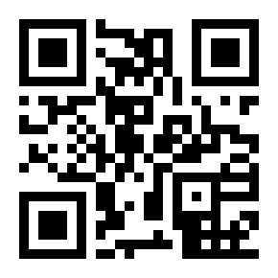
Q&A
@mdelgadodiaz83
mdelgado@pasiona.com
mdelgadodiaz83@techdencias.net
mdelgadodiaz83@gmail.com
@
http://aka.ms/MTS33

